Slide 1
FPO Model Selection
FPO Models Definition
VMK_FPO_MODEL_1_LEVEL_1, device can support uplink ingress path flow classification and marking offload.
VMK_FPO_MODEL_1_LEVEL_2, device can support uplink egress path routing, NAT, and/or Geneve encapsulation offload. If device can only routing or NAT, but not encapsulation offload, it should not claim Model 1 Level 2 support, for it's hard for ENS to offload routing/NAT without offloading Geneve encapsulation due to the order of these actions is fixed today.
VMK_FPO_MODEL_2A, device can support SR-IOV with logical L2 and L3 offloaded to the embedded switch on the device.
VMK_FPO_MODEL_2B, device can support UPT.
VMK_FPO_MODEL_3A, device is a SmartNIC equipped with embedded cores and supports Model 2a.
VMK_FPO_MODEL_3B, device is a SmartNIC equipped with embedded cores and supports Model 2b.
FPO Model Query
call vmk_EnsIsConfigured() first. If ENS is configure, call the following new vmkapis,
VMK_ReturnStatus vmk_FPOModelReport(vmk_Device device, vmk_uint32 driverSupports);
VMK_ReturnStatus vmk_FPOModelQuery(vmk_Device device, vmk_uint32 *ensSupports);
VMK_ReturnStatus vmk_FPOModelSet(vmk_Device device, vmk_uint32 deviceSupports, vmk_uint32 *deviceOperational);
deviceSupports, combination of VMK_FPO_MODEL_*
ensSupports, combination of VMK_FPO_MODEL_*
deviceSupports ⸦ ensSupports, Driver initializes the device in device supported models.
deviceSupports ⸧ ensSupports, Driver initializes the device in ENS supported models.
If max_vfs is configured, and ENS doesn’t support Model 2a, device should enable device in regular SR-IOV mode.
ENS provides command line to configure which model to support.

Slide 2
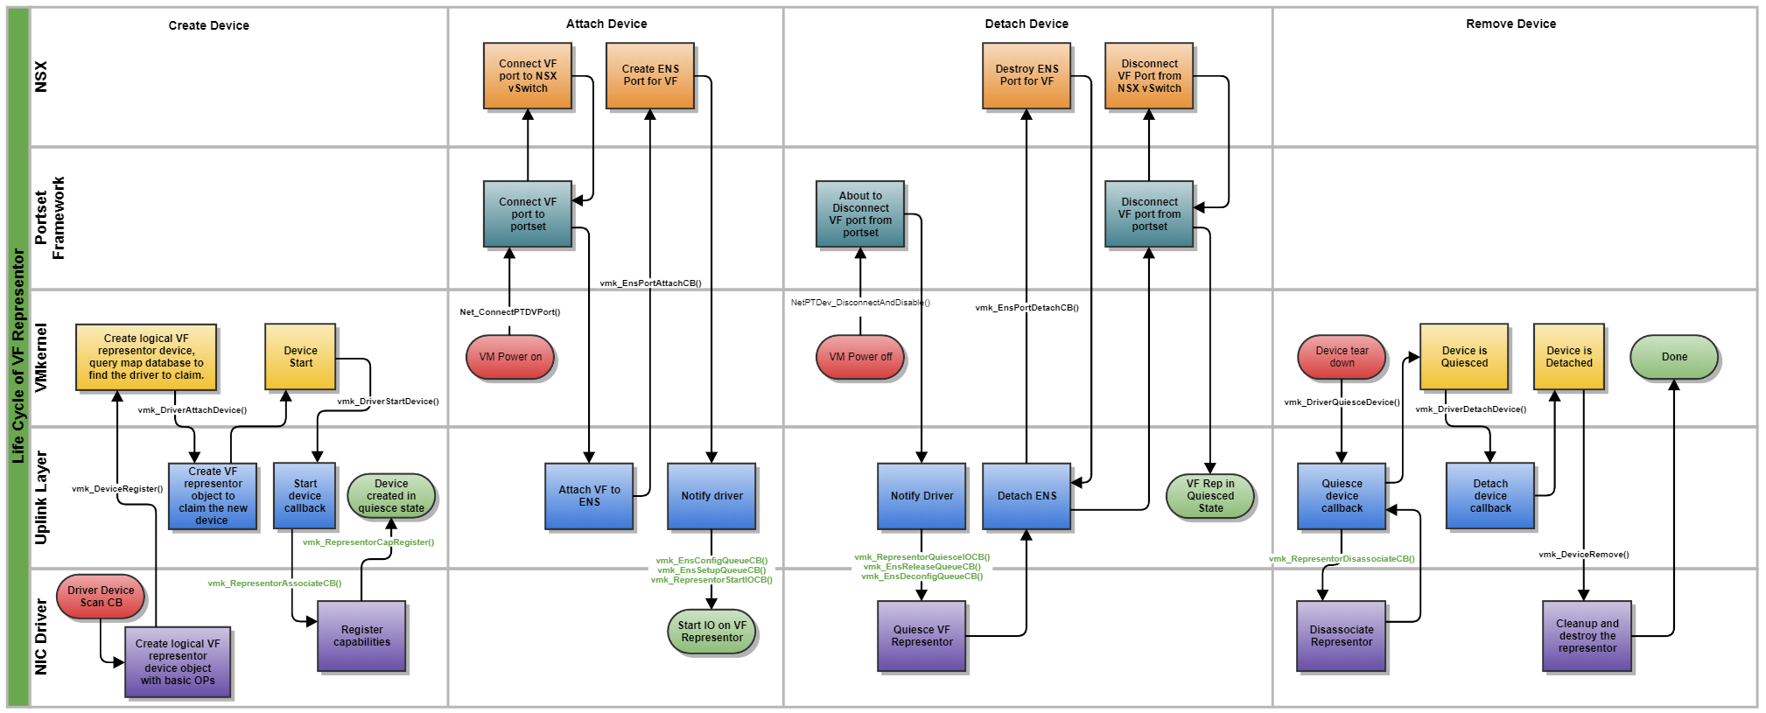
VF Representors

Slide 3
VF Representor Callbacks
Create and Destroy
Invoke vmk_DeviceRegister() in pNIC driver’s ScanDevice callback after PF uplink device object is created.
Populate removeDevice callback in field deviceOps of vmk_DeviceProps passed to vmk_DeviceRegister(), to receive device removal event.
Registration Data
typedef struct vmk_RepresentorInfo {
vmk_RepresentorType type;
union {
struct {
vmk_VFID vfID;
vmk_PCIDeviceAddr vfSbdf;
};
vmk_EthAddress pfMAC;
};
vmk_Device pfUplinkDevice;
vmk_uint32 maxRxQueues;
vmk_uint32 maxTxQueues;
vmk_AddrCookie driverRepData;
} vmk_RepresentorInfo;
typedef VMK_ReturnStatus (*vmk_RepresentorAssociateCB)(vmk_AddrCookie driverData, vmk_Representor rep); typedef VMK_ReturnStatus (*vmk_RepresentorDisassociateCB)(vmk_AddrCookie driverData); typedef VMK_ReturnStatus (*vmk_RepresentorStartIOCB)(vmk_AddrCookie driverData); typedef VMK_ReturnStatus (*vmk_RepresentorQuiesceIOCB)(vmk_AddrCookie driverData); typedef VMK_ReturnStatus (*vmk_RepresentorStatsGetCB)(vmk_AddrCookie driverData, vmk_RepresentorStats *stats);
typedef struct vmk_RepresentorBasicOps { vmk_RepresentorAssociateCB associate; // will be invoked in attach device callback of representor device driver vmk_RepresentorDisassociateCB disassociate; // will be invoked in detach device callback of representor device driver vmk_RepresentorStartIOCB startIO; // will be invoked in start device callback of representor device driver vmk_RepresentorQuiesceCB quiesceIO; // will be invoked in quiesce device callback of representor device driver vmk_RepresentorStatsGetCB statsGet; vmk_EnsBurstTxCB burstTx; // Tx callback to send direct packets to the representor vmk_EnsBurstRxCB burstRx; // Rx callback to poll slow path packets from representor } vmk_RepresentorBasicOps;
typedef enum vmk_RepresentorType { VMK_REPRESENTOR_TYPE_MODEL2_VF, // For VF VMK_REPRESENTOR_TYPE_MODEL3_VF, // For VF exposed to X86 host in Model 3 VMK_REPRESENTOR_TYPE_MODEL3_PF, // For PF exposed to X86 host in Model 3 } vmk_RepresentorType;
typedef vmk_EnsQueueOps vmk_RepresentorQueueOps;
typedef struct vmk_RepresentorRegData { vmk_revnum apiRevision;
vmk_ModuleID moduleID;
vmk_RepresentorInfo *info;
vmk_RepresentorBasicOps *ops; // ops to poll the VF
vmk_RepresentorQueueOps *ops; // ops to poll the VF
} vmk_RepresentorRegData;
#define VMK_REPRESENTOR_DEVICE_IDENTIFIER "com.vmware.representor"

Slide 4
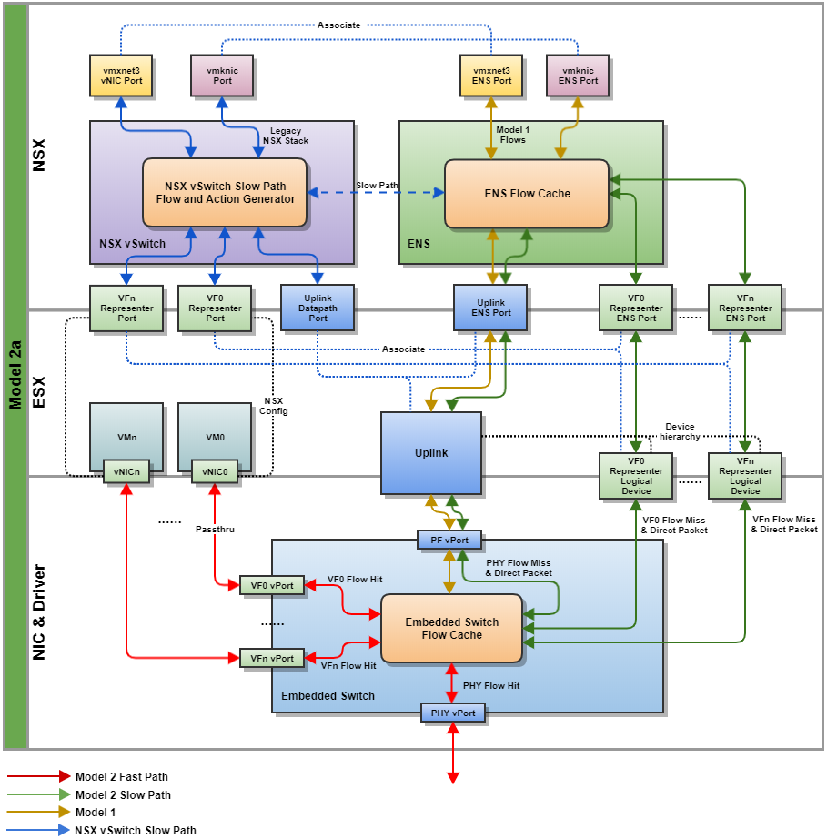
Model 2a Packet Processing

Slide 5
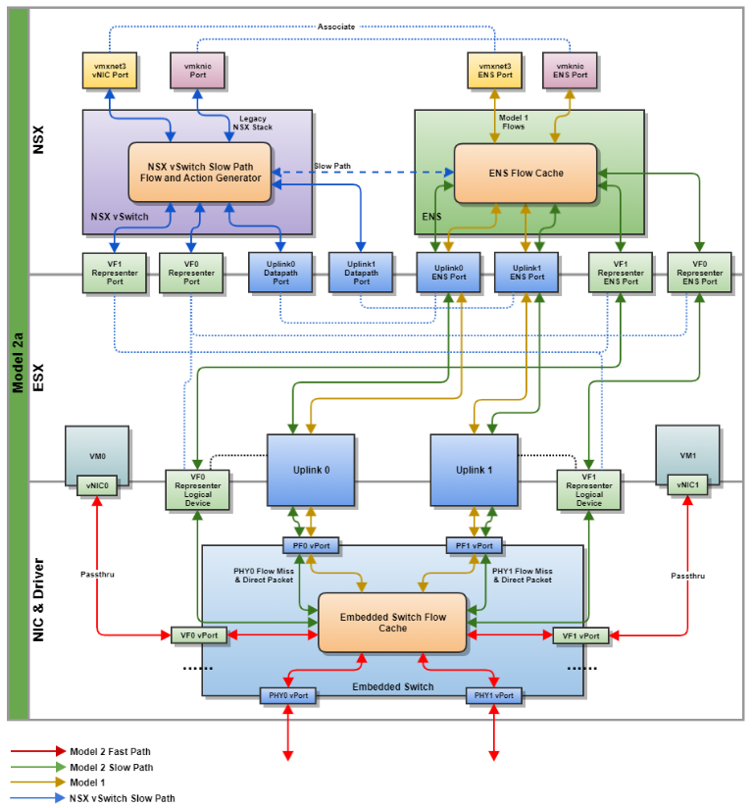
Model 2a Combined Mode

Slide 6
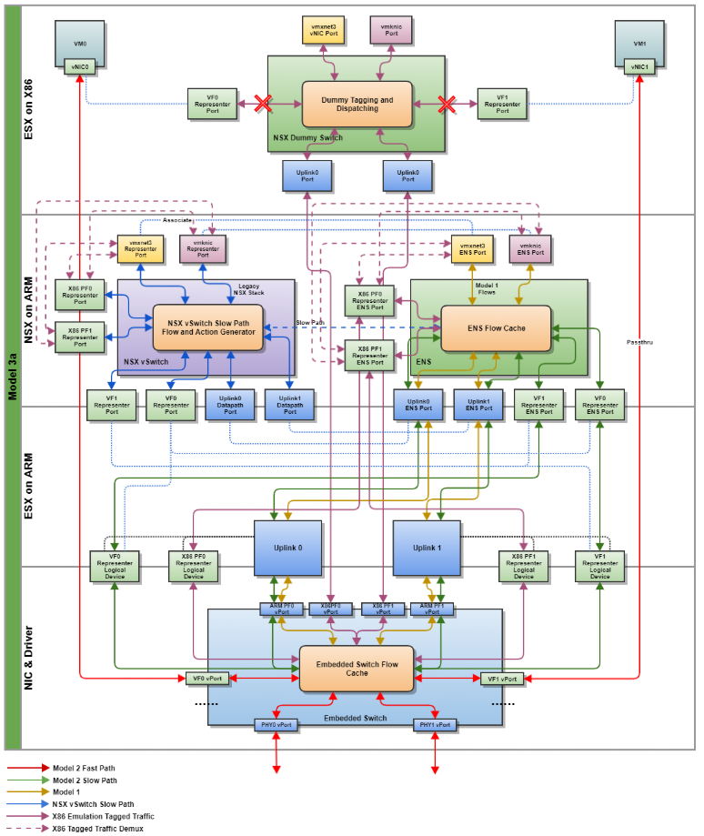
Model 3 PoC

